Slide 1


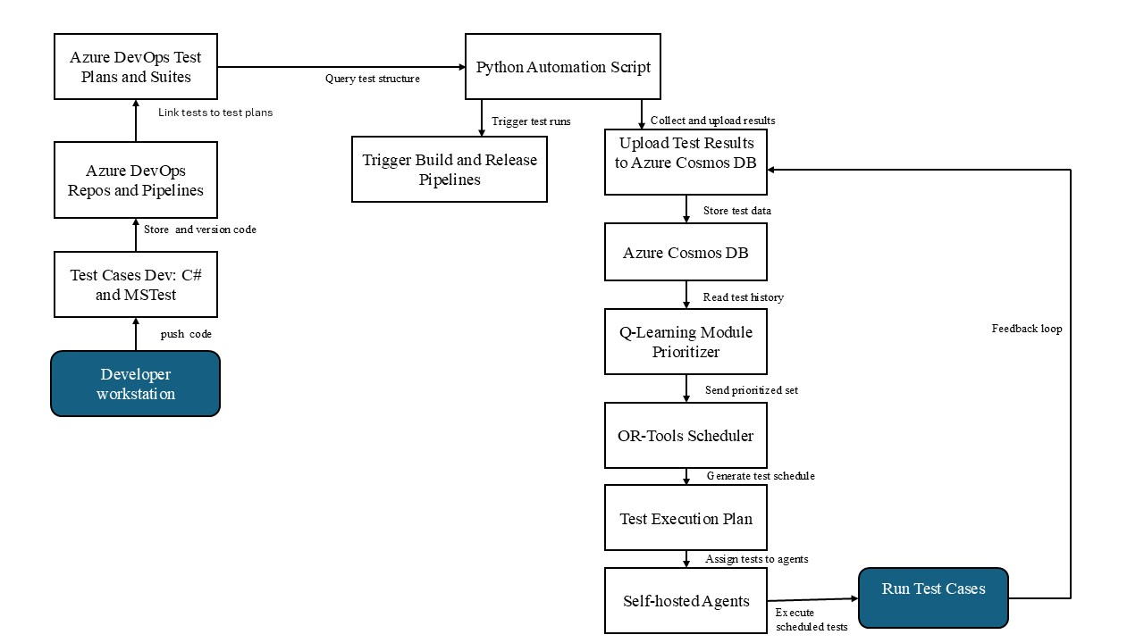
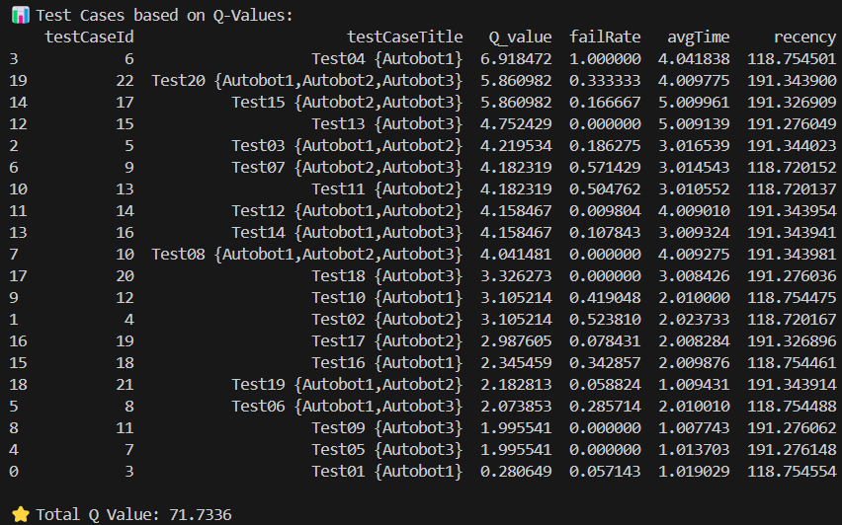
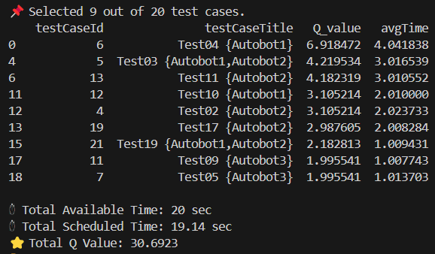
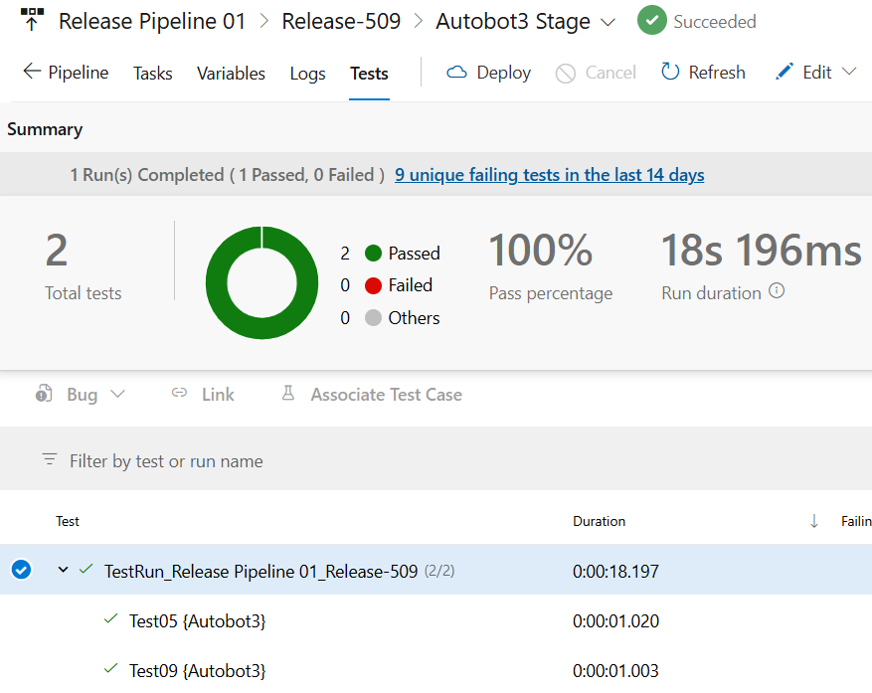
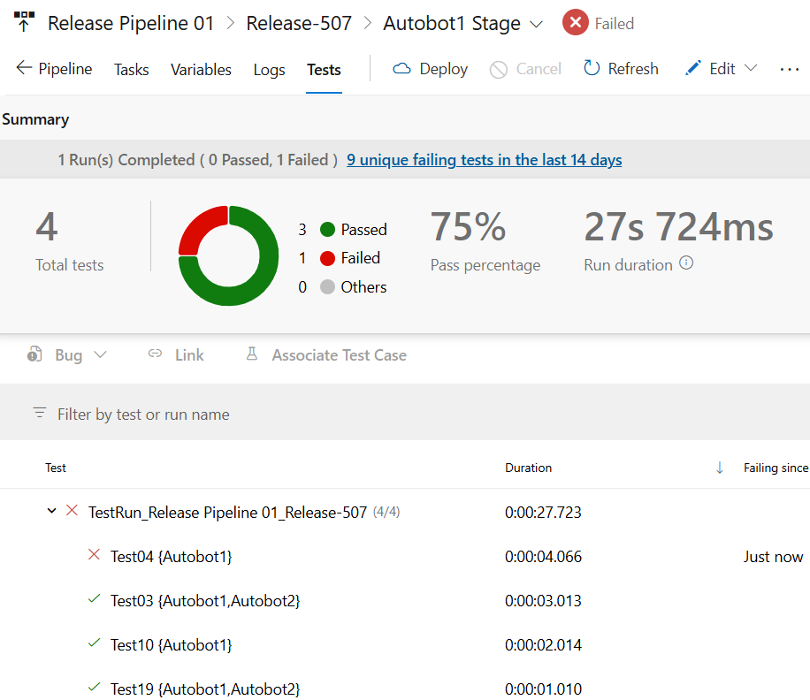
Scheduling and Running Software Test-cases Based on AI
Seth Kofi Agbavitor | B M Nafis Fuad
Master’s Thesis in Computer Science, Spring 2025
Supervisor: Morten Mossige
Introduction
Methodology
Results
Software reliability is very important, especially in robotics, where failures can lead to costly downtime and safety risks. The execution of traditional software tests often follows fixed orders, which limits efficiency and delay fault detection. This project explores intelligent test case scheduling using historical test results and real-time data to prioritize test cases with a higher likelihood of failure. By combining reinforcement learning for dynamic test case prioritization and constraint-based scheduling, the system improves fault detection, reduces testing overhead, and enhances cloud resource utilization.
Problem Statements
In large-scale software testing environments, running all test cases in every CI/CD cycle is time-consuming and inefficient. This thesis addresses the problem of intelligently selecting and scheduling test cases using Q-learning, a reinforcement learning technique. The goal is to maximize fault detection and test effectiveness while minimizing execution time and redundant test runs.
Prioritized Test cases based on Q-Values
System architecture showing the workflow from test development to scheduling and execution.
Conclusion
This project demonstrates that intelligent test case scheduling using Q-learning and constraint-based optimization can significantly improve fault detection and testing efficiency. By leveraging historical and real-time data, the system reduces execution time, minimizes redundant tests, and enhances resource utilization. The successful integration into ABB’s test infrastructure will highlight its practical value in large-scale, safety-critical environments like robotics.
Objectives
Develop a software component that reads and analyzes automated test results stored in Azure Cosmos DB.
Design an AI-based scheduling system that dynamically prioritizes test cases using historical and real-time data.
Apply optimization techniques, including Google OR-Tools, to improve the efficiency of test case scheduling.
Integrate the solution into the ABB internal test infrastructure to improve test execution and resource utilization.
Scheduled Tests using Google OR
References
[1] H. Spieker, A. Gotlieb, D. Marijan, and M. Mossige, “Reinforcement Learningfor Automatic Test Case Prioritization and Selection in Continuous Integration,”in Proceedings of the 26th ACM SIGSOFT International Symposium on SoftwareTesting and Analysis (ISSTA). ACM, 2017, pp. 12–22.
[2] . C. Jorgensen, Software Testing: A Craftsman’s Approach, Fourth Edition. CRCPress, Dec. 2018, google-Books-ID: TvHcDwAAQBAJ.
Azure DevOps Test Logs

